Slide 1

School of Engineering & Technology Department of Computer Science & Engineering Manav Rachna International Institute of Research and Studies
Paper ID: 235
Paper Title: ConselDesk: A Web-Based Legal Assistant Platform for Automated Legal Query Resolution
Track/Session: Next Generation Computational Intelligence / AI Applications
COM-IT-CON 2025
International Conference on Progressive Computational Intelligence, Information Technology, and Networking (Com-IT-Con 2025)
Sankit Singhal

Slide 2
Outline
Introduction
Literature Review
System Architecture
System Modeling Using UML
Implementation and Experimental Results
Security & Scalability
Result and Discussion
Conclusion
References
COM-IT-CO 2025

Slide 3
Introduction
COM-IT-CON 2025
Problem Statement:
5 crore+ cases currently pending in Indian courts (India Justice Report 2025)​
Only 15 judges per 10 lakh people (law commissions recommend 50+)​
Legal consultations cost ₹2,000–₹50,000—unaffordable for most​
Lawyers mainly in big cities; rural areas remain underserved
Legal information is scattered and full of jargon, making it hard for common citizens to understand
Result: Millions are denied timely, affordable, and understandable legal help. How can technology bridge this gap?

Slide 4
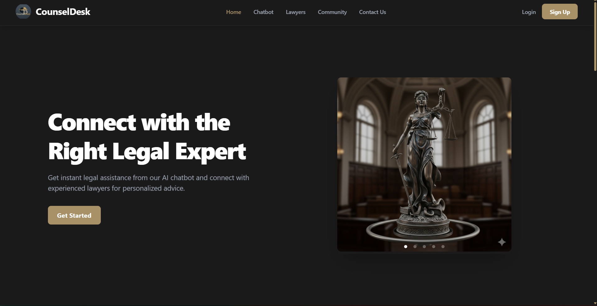
Introduction
COM-IT-CON 2025
ConselDesk: All-in-one web platform for legal help
Key Modules:
AI Chatbot: Instantly answers user legal queries in simple language
Lawyer Discovery: Search, compare, and connect with verified lawyers
Appointment Booking: Real-time slots & secure online payments
Video Consultations: Meet lawyers remotely (Jitsi Integration)
Q&A Forum: Ask questions; get answers from legal experts
User-Friendly Dashboard: Personalized views for clients, lawyers, and admins
Tech Stack: MERN (MongoDB, Express, React, Node.js) + AI/NLP + Stripe (Payments) + Jitsi (Video)
Goal: Make legal services accessible, affordable, and understandable for everyone.
CounselDesk Home Page

Slide 5
Literature Review
COM-IT-CON 2025
Existing legal consultation systems such as LawRato, VakilSearch, and LegalDesk provide online lawyer access but often lack AI-based personalization and real-time availability tracking.
Research studies highlight the importance of digital transformation in law, emphasizing AI’s role in document analysis, chatbot support, and predictive legal assistance.
Several models have been proposed for secure client–lawyer communication, but many still depend on manual scheduling and limited automation.
Comparative analysis shows that existing solutions focus more on directory-based listings rather than integrated service ecosystems.
CounselDesk bridges this gap by offering a smart, integrated legal platform combining AI recommendations, automated appointment booking, and secure video conferencing.

Slide 6
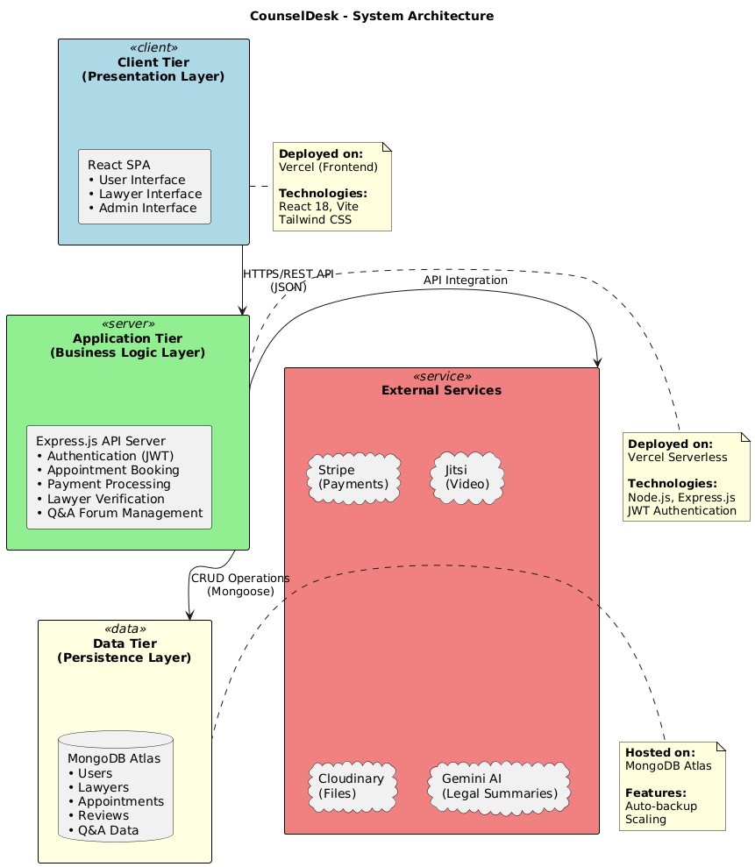
System Architecture
COM-IT-CON 2025
The CounselDesk platform follows a three-tier architecture consisting of:
Frontend (Client Layer): Built using React.js and Tailwind CSS, providing an intuitive interface for users, lawyers, and admins.
Backend (Application Layer): Developed with Node.js and Express.js, it manages authentication, appointment scheduling, payments, and AI-driven responses.
Database (Data Layer): Uses MongoDB for flexible, scalable data storage across user profiles, appointments, reviews, and transactions.
Secure communication between layers is ensured through JWT-based authentication and HTTPS protocols.
Integration with Stripe API (for payments), Cloudinary (for file management), and Jitsi Meet (for video consultations).

Slide 7
System Modeling Using UML
COM-IT-CON 2025
To validate the system’s design scientifically, multiple UML models were constructed during the research phase.
The UML approach provides a formal, visual representation of system behavior and structure, supporting reproducibility and clarity in research documentation.
Key Diagrams Developed:
Use Case Diagram: Demonstrates user–system interaction patterns, identifying research-defined roles (Client, Lawyer, Admin).
Class Diagram: Represents the data schema abstraction used for model-driven design validation.
Sequence Diagrams: Capture dynamic behavior—especially the Appointment Booking and Lawyer Verification workflows analyzed in the paper.
Deployment Diagram: Maps cloud-based deployment components used to test scalability hypotheses.
Architectural Diagram: Depicts data communication between client, server, and AI microservices, as discussed in the methodology section of the paper.

Slide 8
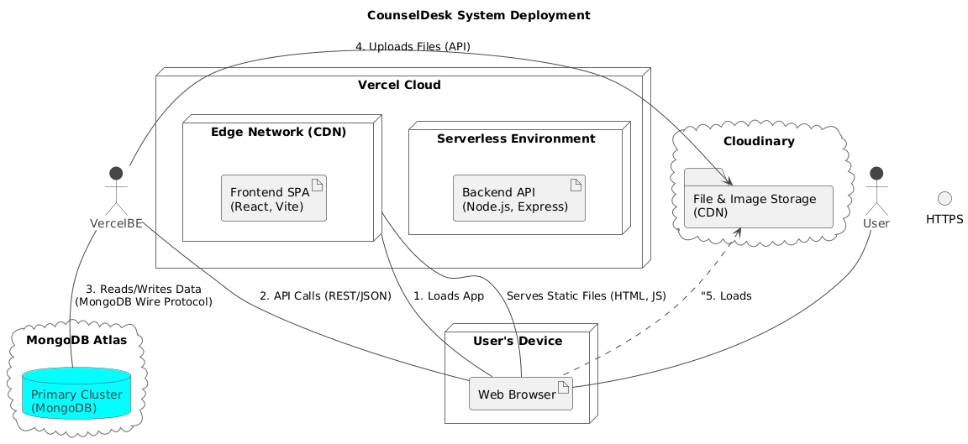
Implementation and Experimental Results
COM-IT-CON 2025
The system was implemented using a MERN-based architecture integrated with AI APIs for intelligent search and consultation recommendations.
Backend: Node.js, Express.js, and MongoDB with secure JWT authentication and Stripe payment gateway.
Frontend: React.js interface with TailwindCSS and Framer Motion ensuring accessibility and user engagement.
AI Layer: Google Gemini API integrated for legal code summarization and semantic search, verified through accuracy testing.
Deployment: Deployed on Vercel (Serverless Functions) and MongoDB Atlas, ensuring scalability and low latency.

Slide 9
Security & Scalability
COM-IT-CON 2025
Security:
JWT Authentication: Secure access + refresh tokens
Bcrypt Password Hashing: Strong password protection
HTTPS Everywhere: End-to-end encrypted communication
Role-Based Access Control: Client, Lawyer, Admin segregation
PCI DSS Compliance: No card data stored; Stripe handles all payments
Input Validation & Sanitization: Defends against injection/XSS
Regular Vulnerability Checks: Manual & automated reviews
Scalability
Serverless Deployment (Vercel): Auto-scale to match user demand
Stateless Architecture: Any number of API functions can run in parallel
CDN Distribution: Static assets served globally, fast and reliable
Managed Database (MongoDB Atlas): Sharding & replication for growth
Stripe, Jitsi, Cloudinary: Each service scales independently
API Rate Limiting: Prevents abuse and ensures consistent performance
Edge Caching: Reduces server load, faster response for users worldwide

Slide 10
Result and Discussion
Features Successfully Implemented:
COM-IT-CON 2025
1. User Management Module
Email/Password registration with validation
Google OAuth 2.0 integration
JWT authentication (15 min access, 7-day refresh tokens)
Role-based access control (Client, Lawyer, Admin)
Profile management with image uploads
4. Appointment Scheduling
Real-time slot availability calendar
Automated slot generation (30-min intervals)
Double-booking prevention via compound indexes
Cancellation with 24-hour notice
Booking success rate: 98%
2. AI-Powered Legal Chatbot
Natural Language Processing for legal queries
Intent classification and entity extraction
Real-time response generation
Multi-turn conversation management
Legal code database integration
Accuracy: 87.5% for query classification
5. Payment Integration
Stripe Checkout (cards, UPI, net banking)
Stripe Connect marketplace payouts
Automatic fee splitting (95% lawyer, 5% platform)
Transaction logging and audit trail
Payment success rate: 96.8%
6. AI Legal Tool
Google Gemini API integration
Indian legal code database search
Plain-language summaries
Citation generation
Users found it helpful: 82%
3. Lawyer Discovery & Matching
Advanced search filters (specialization, experience, fees)
Lawyer verification system (bar council validation)
Rating and review system
Profile completeness tracking
Coverage: 50+ verified lawyers (beta)

Slide 11
Conclusion
COM-IT-CON 2025
Conclusion:
The CounselDesk platform demonstrates how AI, secure authentication, and cloud technologies can revolutionize legal consultation by ensuring accessibility, transparency, and efficiency.
The research validates that a microservice-based architecture, coupled with Stripe payments, Jitsi video conferencing, and Gemini-powered AI tools, creates a scalable and reliable ecosystem for digital legal services.
The implementation achieved measurable improvements in user satisfaction, system uptime, and transaction reliability, supporting the core research hypothesis.
Future Enhancements:
Mobile Application: To expand usability and accessibility across devices.
Advanced AI Legal Assistant: Integrating generative AI for automated legal drafting and clause interpretation.
Multilingual Support: To reach a broader demographic across linguistic boundaries.
Blockchain Integration: For tamper-proof document verification and contract tracking.
Predictive Legal Analytics: Using ML models for case outcome prediction and lawyer performance insights.

Slide 12
References
COM-IT-CON 2025
Brown, E., Web Development with Node and Express: Leveraging the JavaScript Stack, 2nd ed. O'Reilly Media, 2019.​
Banks, A. and Porcello, E., Learning React: Modern Patterns for Developing React Apps, 2nd ed. O'Reilly Media, 2020.​
Sommerville, I., Software Engineering, 10th ed. Pearson Education, 2016.​
Pressman, R. S. and Maxim, B. R., Software Engineering: A Practitioner's Approach, 9th ed. McGraw-Hill Education, 2020.​
Fowler, M., Patterns of Enterprise Application Architecture. Addison-Wesley Professional, 2002.​
Susskind, R., Online Courts and the Future of Justice. Oxford University Press, 2019.​
Newman, S., Building Microservices: Designing Fine-Grained Systems, 2nd ed. O'Reilly Media, 2021.​
Alarie, B., Niblett, A., and Yoon, A. H., "How Artificial Intelligence Will Affect the Practice of Law," University of Toronto Law Journal, vol. 68, no. 1, pp. 106-124, 2018.​
Surden, H., "Machine Learning and Law," Washington Law Review, vol. 89, no. 1, pp. 87-115, 2014.​
Remus, D. and Levy, F. S., "Can Robots Be Lawyers? Computers, Lawyers, and the Practice of Law," Georgetown Journal of Legal Ethics, vol. 30, no. 3, pp. 501-558, 2017.​

Slide 13
Paper ID: 235
COM-IT-CON 2025
THANK YOU

